Slide 1

MIRPUR UNIVERSITY OF SCIENCE AND TECHNOLOGY (MUST), MIRPUR DEPARMENT OF COMPUTER SCIENCE & INFORMATION TECHNOLOGY

Slide 2
Professional Practices BIT-4802 Lecture [2] : Software Engineering and Professional Issues
Dr. Samina Khalid
(Assistant Professor)
Date: April 23, 2020

Slide 3

Definitions (taken from lecture-7)
Ethics
the discipline dealing with what is good and bad, and with moral duty and obligation
A set of moral principles or values
A theory or system of moral values.
The principles of conduct governing an individual or a group
Ethical
Of or relating to ethics.
Conforming to accepted professional standards of conduct
Professionalism
The conduct , aims, or qualities that characterize or mark a professional person
.
*Webster’s Seventh New Collegiate Dictionary, G.&C. Merriam Co.,1966.

Slide 4
Today’s Agenda
Introduction to Software Engineering Professional Issues
SWEnet OSE2 Module, June 2003

Slide 5
Overview
The Software Engineering Profession
Professional Societies
Certification, and Licensing
Software Engineering Education & Training
Ethics and Professional Conduct

Slide 6
The Software Engineering Profession
Software engineering (SE) as a discipline and profession is relatively young, some even say “immature”.
In 1996, Ford and Gibbs [6] listed designated eight infrastructure components that can be used to evaluate a mature profession:
– a professional society
– initial professional education
– skills development
– professional development
– accreditation
– certification
– licensing
– a code of ethics
In the following slides, we will discuss these elements in relation to the current state of the software engineering profession.

Slide 7
Professional Societies
There is no professional society devoted exclusively to software engineering, but there are two societies which provide mature support for the software engineering profession:
Association for Computing Machinery (ACM) (http://www.acm.org/)
Founded in 1947, ACM has 75, 000 members and has the objective of advancing the skills of computing professionals and students worldwide.
The ACM has 34 “special interest groups” (SIGS). The Special Interest Group on Software Engineering (SIGSOFT) focuses on issues relating to all aspects of software development and maintenance.
https://www.acm.org/code-of-ethics#:~:text=The%20Code%20includes%20principles%20formulated,understanding%20and%20applying%20the%20principle.

Slide 8
Professional Societies
2. IEEE Computer Society (IEEE-CS) (http://computer.org/)
Founded in 1946, with nearly 100, 000 members, it is the largest of the 36 societies of the Institute of Electrical and Electronics Engineers (IEEE).
The Computer Society's vision is to be the leading provider of technical information and services to the world's computing professionals

Slide 9
Certification and Licensing - 1
Certification is a voluntary process administered by a profession.
Currently there are many certification programs for various computing technologies:
Many are brand name certifications (e.g. Cisco, Java/Sun, Microsoft, Novell, etc.) and do not deal with the software engineering profession directly.

Slide 10
Certification and Licensing - 1
The IEEE-CS offers a certification titled Certified Software Development Professional (CSDP) [7]. The CSDP has the following components:
At the time of application the candidate holds:
A baccalaureate or equivalent university degree and
Has a minimum of 9,000 hours of software engineering experience within at least six (6) of the eleven (11) SE knowledge areas (the ten SWEBOK areas [5] and Professionalism and Engineering Economics).
https://en.wikipedia.org/wiki/Software_Engineering_Body_of_Knowledge

Slide 11
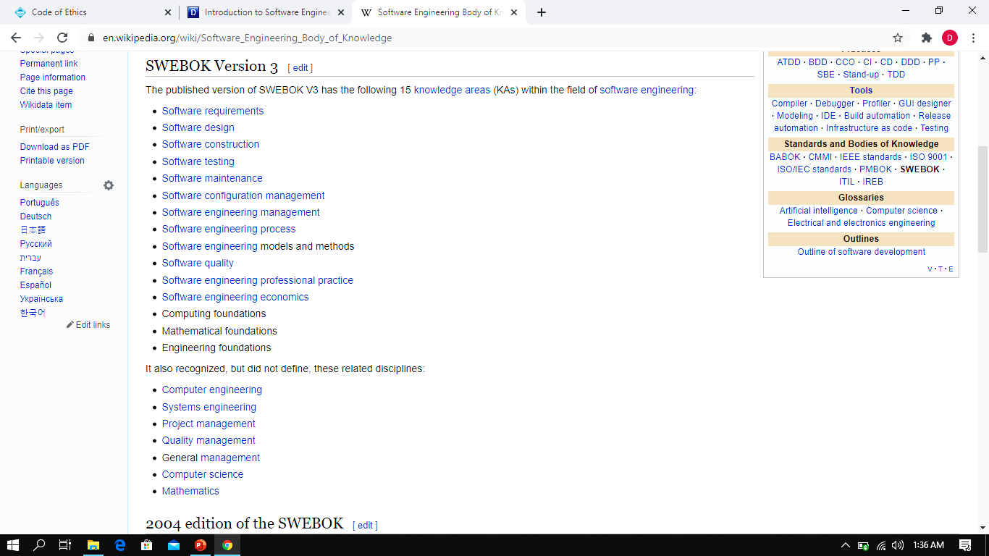

Slide 12
Certification and Licensing - 1
The IEEE-CS offers a certification titled Certified Software Development Professional (CSDP) [7]. The CSDP has the following components:
Candidates are required to subscribe to the Software Engineering Code of Ethics and Professional Practice [3]
Candidates must pass an exam demonstrating mastery of the knowledge areas

Slide 13
Certification and Licensing - 2
Licensing is a mandatory process administered by a governmental authority.
In the U.S. licensing is administered at the state level.
Only about 18% of U.S. engineers (civil, electrical, mechanical , etc.) are registered.
Texas is currently the only state to license software engineers.

Slide 14
Research Papers
Following Research papers will be discussed in class:
Professional Issues in Software Engineering Curricula: Case Studies on Ethical Decision Making [5]
Sustainability in Software Engineering Education: a case of general professional competencies [6]

Slide 15
References
Accreditation Board for Engineering and Technology – home page (http://www.abet.org/)
Association of Computing Machinery – home page (http://www.acm.org/)
ACM/IEEE-CS Joint Task Force on Software Engineering Ethics and Professional Practices, Software Engineering Code of Ethics and Professional Practice , Version 5.2, (http://www.acm.org/serving/se/code.htm)
Boehm, B., et. al., Position Papers on Software Engineering & Licensing, (http://www.acm.org/serving/se_policy/papers.html)
Georgiadou, E. and Oriogun, P.K., 2001, July. Professional issues in software engineering curricula: case studies on ethical decision making. In Proceedings International Symposium on Technology and Society (pp. 252-261). IEEE.
Semerikov, S.O., Striuk, A.M., Striuk, L., Striuk, M. and Shalatska, H.M., 2020. Sustainability in Software Engineering Education: a case of general professional competencies. In E3S Web of Conferences. The International Conference on Sustainable Futures: Environmental, Technological, Social and Economic Matters (ICSF 2020) (No. 166, pp. 1-13). EDP Sciences.

Slide 16
THANKS

